Slide 1
Online Role-based training resources: Microsoft Learn https://docs.microsoft.com/en-us/learn/

Slide 2
Module 8: Create Dashboards

Slide 3
Learning Objectives
You will learn the following concepts:
Dashboards
Real-time Dashboards
Enhancing Dashboards
Notes:
By the end of this module, you’ll be able to:
Create and use Dashboards and understand their purpose.
Create Real-time dashboards
Enhancing existing dashboards

Slide 4
Module Agenda
Create a Dashboard
Real-time Dashboards
Enhance a dashboard

Slide 5
Lesson 1: Create a Dashboard

Slide 6
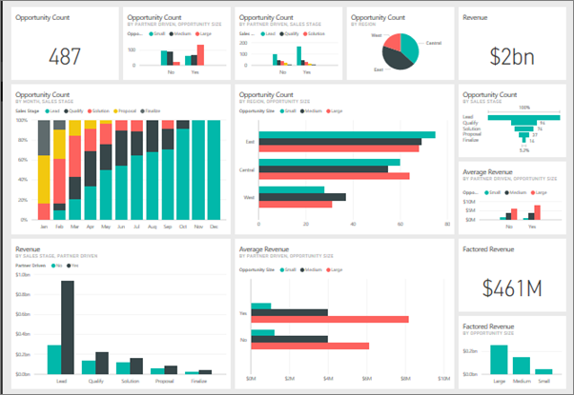
Introduction to Dashboards
A dashboard:
Is a single-page canvas that tells a story through visualizations.
Can draw from multiple reports.
Contains no Filter, Visualization, or Fields pane.
Does not display the underlying dataset.
Notes:
A Power BI dashboard is a single page, often called a canvas, that tells a story through visualizations. Because it's limited to one page, Well-built dashboards capture the main, most important highlights of the story that you are trying to tell. Readers can view related reports for the details.
Microsoft Power BI dashboards are different than Power BI reports. Dashboards allow report consumers to create a single artifact of directed data that is personalized just for them. Dashboards can be comprised of pinned visuals that are taken from different reports. Where a Power BI report uses data from a single dataset, a Power BI dashboard can contain visuals from different datasets.
When would you want to build a dashboard versus a report? The following list explains the key similarities and differences worth noting when you are determining the right path for you:
Dashboards can be created from multiple datasets or reports.
Dashboards do not have the Filter, Visualization, and Fields panes that are in Power BI Desktop, meaning that you can't add new filters and slicers, and you can't make edits.
Dashboards can only be a single page, whereas reports can be multiple pages.
You can't see the underlying dataset directly in a dashboard, while you can see the dataset in a report under the Data tab in Power BI Desktop.
Both dashboards and reports can be refreshed to show the latest data.
Tiles are the individual report elements, or snapshots, of your data that are then pinned to a dashboard. You can pin an entire report page, or you can pin individual tiles.
Report: The pinning process pulls visuals from your report and "pins" them to a dashboard for easy viewing. When you make changes to any of the visuals in the report, changes will be reflected on the dashboard.
Visual: You can pin a visual from a different report (and different dataset) to an existing dashboard. When pinning a report element to a dashboard, you create a direct connection between the dashboard and the report that the snapshot came from.

Slide 7
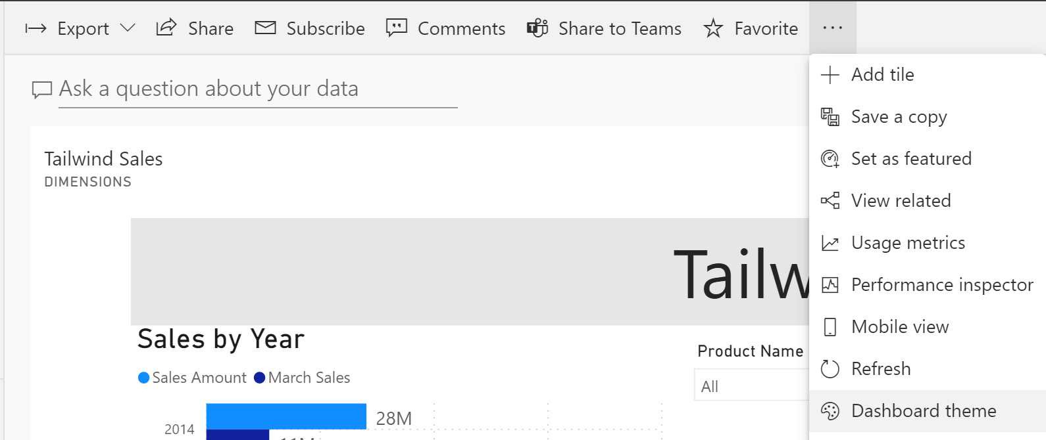
Add a Dashboard Theme
Create a cohesive picture across dashboards using themes.
Notes:
When building dashboards, you should consider ensuring that the same theme is applied to your dashboards to create a cohesive picture. You could also apply a specific theme to reports and dashboards so that all report elements or tiles are uniform. This consideration is particularly important when you are building multiple dashboards. Power BI has the functionality to apply a theme directly to all visuals of a report.
Themes in Power BI
A variety of themes are available for use in Power BI service. Go to a dashboard, select the ellipsis (...), and then select Dashboard theme.

Slide 8
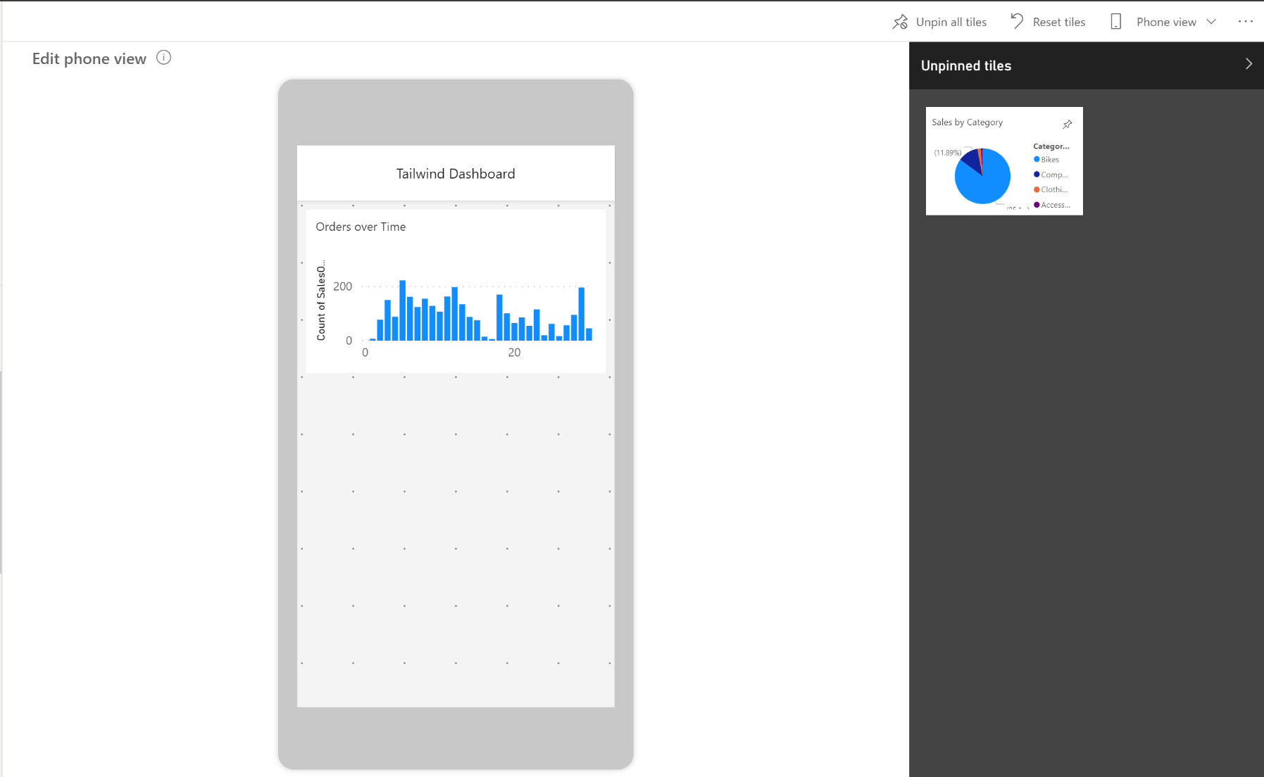
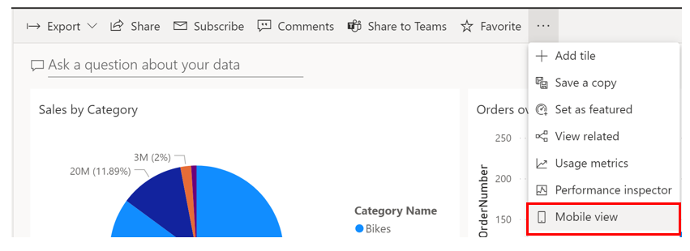
Set Mobile View
Let your users stay connected wherever they are.
Notes:
Power BI reports are built in Power BI Desktop and then deployed to Power BI service, where they can be viewed and shared. However, if you are building dashboards for the Sales team at your organization and you receive a requirement that the dashboards should also be viewable on mobile devices, Power BI will help you to set dashboards to mobile view.
In the mobile view in Power BI Desktop, you are able to accomplish several tasks. This view emulates the view of a user who is looking at visuals on their phone, so you can add visuals to this view, resize them, and change the formatting on them, as shown in the ensuing screenshot. In the June 2020 release of Power BI Desktop, a new grid has been added to this view so that you can position your visuals with more ease and overlay visuals on top of each other. This feature can be useful if you want to insert a visual on top of an image.
When you view dashboards in portrait mode on a phone, you notice the dashboard tiles are laid out one after another, all the same size. In the Power BI service, you can create a customized view of a dashboard, specifically for portrait mode on phones. Even if you create a phone view, when you turn the phone sideways, you see the dashboard as it's laid out in the service.
LIVE means: As you edit the phone view, anyone viewing the dashboard on a phone can see the changes you make in real time. For example, if you unpin all tiles on the dashboard phone view, the dashboard on the phone will suddenly have no tiles.
You can also optimize your dashboards for mobile view in Power BI service.
Benefits:
Resize and reposition the tiles and visuals in whichever order you want.
This phone view is customizable for each person who uses the dashboard; selecting Phone view will allow you to create a new view that you can see on your phone when signing in to Power BI service.
A new grid has been added to this view so that you can position your visuals with more ease and overlay visuals on top of each other. This feature can be useful if you want to insert a visual on top of an image.
You can add visuals to this view, resize them, and change the formatting on them,

Slide 9
Review Questions
Q01 – What is a dashboard?
A01 – A canvas of report elements that can be built in Power BI service.
Q02 – What is one way that reports and dashboards differ?
A02 – In reports, you can have multiple pages; in dashboards, you can have only one page.
Q03 – Can a dashboard be created from multiple reports?
A03 – Yes, dashboards can be created from multiple datasets or reports.

Slide 10
Lesson 2: Real-time Dashboards

Slide 11
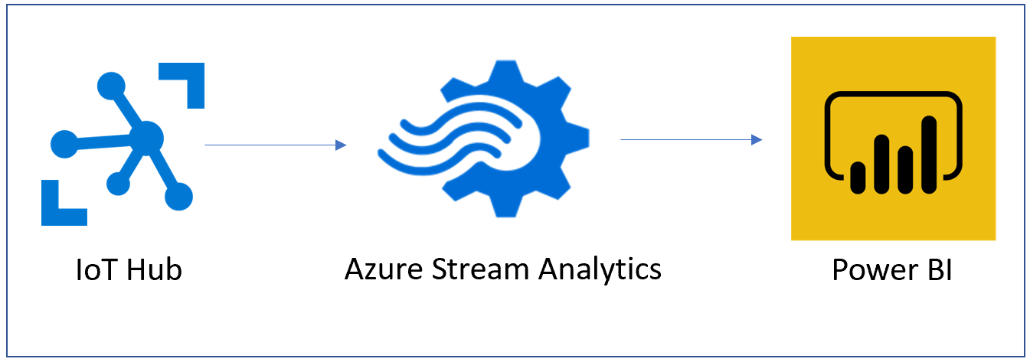
Create a Real-time Dashboards
Stream data and update dashboards as soon as the data is logged.
Notes:
In this data-centric world, it has become increasingly important to have the ability to view how data changes in real time. This ability is particularly important in the context of dashboards; these are the canvases on which you can tell the story of the data, so the ability to show real-time, streaming data on these dashboards can be important to your business. With Power BI's real-time streaming capabilities, you can stream data and update dashboards as soon as the data is logged.
Streaming data can come from a variety of sources, including from social media, factory sensors, service-usage metrics, and other sources that contain a constant stream of data points. A common scenario are sensors that send a stream of telemetry data to IoT hub. From the IoT hub, you can use a stream insight job to aggregate the data, then you can retrieve the data into Power BI as a streaming dataset, where you can consume the information and build the pertinent visuals.
Data that comes from a streaming dataset is not stored in a Power BI data model; instead, it is stored in a temporary cache. Consequently, you cannot model the data with this type of dataset. The only way to visualize the data from a streaming data source is to create a tile directly on a dashboard and use a custom streaming data source.
After you have selected the new dataset, select Next, enter the details for your streaming dataset, and then add a new streaming dataset tile. Streaming dataset tiles can be in the form of line charts, stacked bar charts, cards, and gauges and are formatted similarly to any other kind of tile.

Slide 12
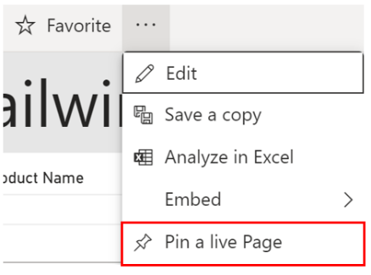
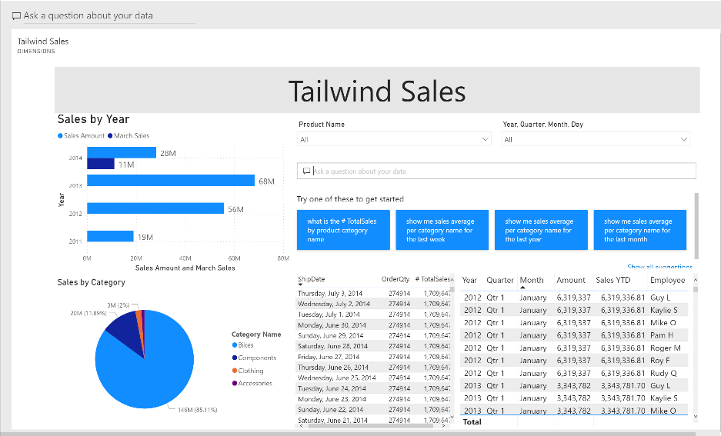
Pin a Live Report Page to a Dashboard
Ensure the visuals on your dashboard reflect changes live.
Notes:
The process of building reports and dashboards is iterative. As data is constantly refreshed and business requirements change, it is expected that your reports and dashboards might also change; both in what filters or slicers you might have and also in what report elements, charts, and cards you have. For this reason, it is crucial that Power BI supports this iterative process. Through Power BI's innate functionality to pin live report pages to a dashboard, you can ensure that you aren't using old data and the visuals on your dashboards reflect changes live.
Pin a live page
When you pin a visual, you can add it to a new or an existing dashboard. You can do the same with entire reports; when you pin a report page, all visuals on the report will be pinned to a dashboard and they are also live, meaning that any changes you make on the report will be immediately reflected on the dashboard that you have pinned the report to.
When you pin an entire page, the tiles are live; you can interact with them right there on the dashboard. And changes you make to any of the visualizations back in the report editor are reflected in the dashboard tile as well.
Any changes that you make to the tickets report will automatically show on the dashboard when the page is refreshed. In Power BI Desktop, you can make changes to your visuals or data as needed and then deploy to the appropriate workspace file, which will update the report and simultaneously update the dashboard as well.

Slide 13
Review Questions (1)
Q01 – What is a key benefit of Power BI’s real-time streaming capabilities?
A01 – You can stream data and update dashboards as soon as the data is logged.
Q02 – Pinning an entire report page to a dashboard ensure what?
A02 – Pinning a page is an easy way to pin more than one visualization at a time. Also, when you pin an entire page, the tiles are live; you can interact with them right there on the dashboard.

Slide 14
Lesson 3: Enhance a dashboard

Slide 15
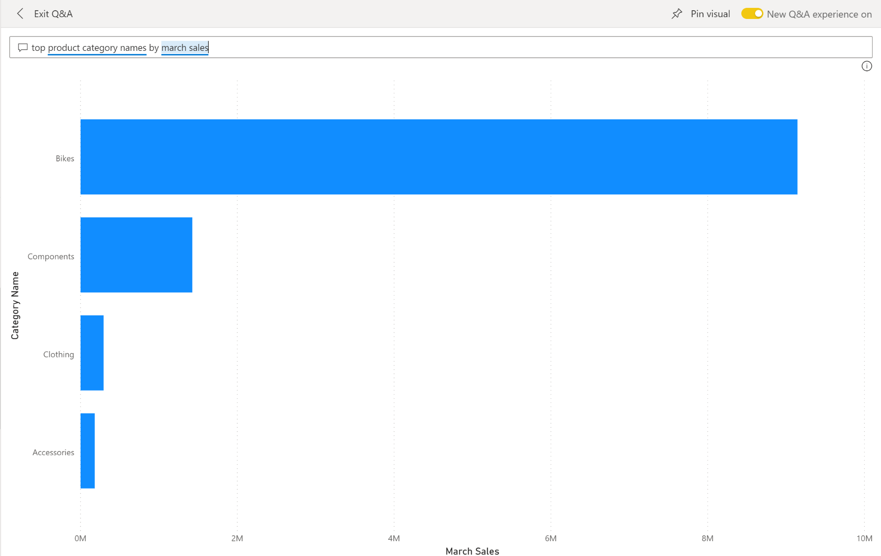
Explore Data by Asking Questions
Sometimes the fastest way to get an answer from your data is to ask a question using natural language.
Notes:
EXPLORE DATA IN YOUR OWN WORDS.
Power BI dashboards are about having a user-friendly experience. Dashboards in Power BI service are comprised of a canvas of interactive tiles, or report elements, that tell a data story. Sometimes the fastest way to get an answer from your data is to ask a question using natural language. The Q&A feature in Power BI lets you explore your data in your own words.
Q&A is interactive, even fun. Often, one question leads to others as the visualizations reveal interesting paths to pursue.
With Q&A, not only can you ask your data to speak for itself, you can tell Power BI how to display the answer. Just add "as a " to the end of your question. For example, "show inventory volume by plant as a map" and "show total inventory as a card". Try it for yourself.
When you're happy with the result, pin the visualization to a dashboard by selecting the pin icon in the top right corner.
Three main elements to the Q&A feature:
Question box: Enter their question about the data. An example of a question could be: What was the average sales amount by category? Entering this question will trigger Power BI's natural-language analysis engine to parse and determine the appropriate data to display.
Suggestion tiles: Contains tiles with pre-populated suggestions for questions that the user can consider asking. When the user selects one of these tiles, they will be shown analysis.
Pin visual: An icon that allows you to pin the visual into a new or existing dashboard.

Slide 16
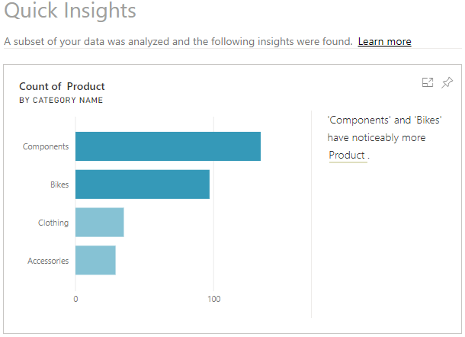
Quick Insights
Uses Machine Learning algorithms to produce quick insights.
Uncover insights missed during report construction.
Generate stimulating visual interactions.
Notes:
The Quick insights feature in Power BI uses machine learning algorithms to run over your entire dataset and produce insights (results) for you, very quickly. This feature is a great way to build dashboards, when you don't know where to start. It also helps you to determine any insights you might've missed when building out your reports. From the insights that Power BI discovers, you can generate interesting interactive visualizations.
NOTE: This feature is available in the Power BI Web Service only. Also, this feature doesn't work with DirectQuery; it only works with data imported to Power BI.
To get quick insights on your dataset, open your Power BI Web Service, then select the Content tab. Locate your report for which you want to get quick insights, then select More options (...) > Quick insights.
Power BI will use various algorithms to search for trends in your dataset. This process might take a few seconds but when it is finished, you'll see a message in the top right corner letting you know that the results are ready to be viewed.
Select View insights to open the Quick Insights page for the selected dataset and view the insights that Power BI found for you. The Quick Insights page contains up to 32 separate insight cards, and each card has a chart or graph, plus a short description.
Add the Quick Insights card to your report: If you see an insight card that is particularly interesting, you can add it to your report. On the Quick Insights page, hover over the card, then select the pin icon. The visual is added to your dashboard, where you can reposition it as required.
Interact with the results: To take a closer look at a particular insight card on the Quick Insights page, select an insight card to open the insight screen opens in Focus mode.
You can then perform the following actions:
Filter the visualization using the available options in the Filters panel.
Pin the insight card to a dashboard by selecting Pin visual.
Run insights on the card itself (scoped insights) by selecting Get insights in the top-right corner. The scoped insights allow you to drill down deeper into your data.
Return to the original insights canvas by selecting Exit Focus mode in the top-left corner.

Slide 17
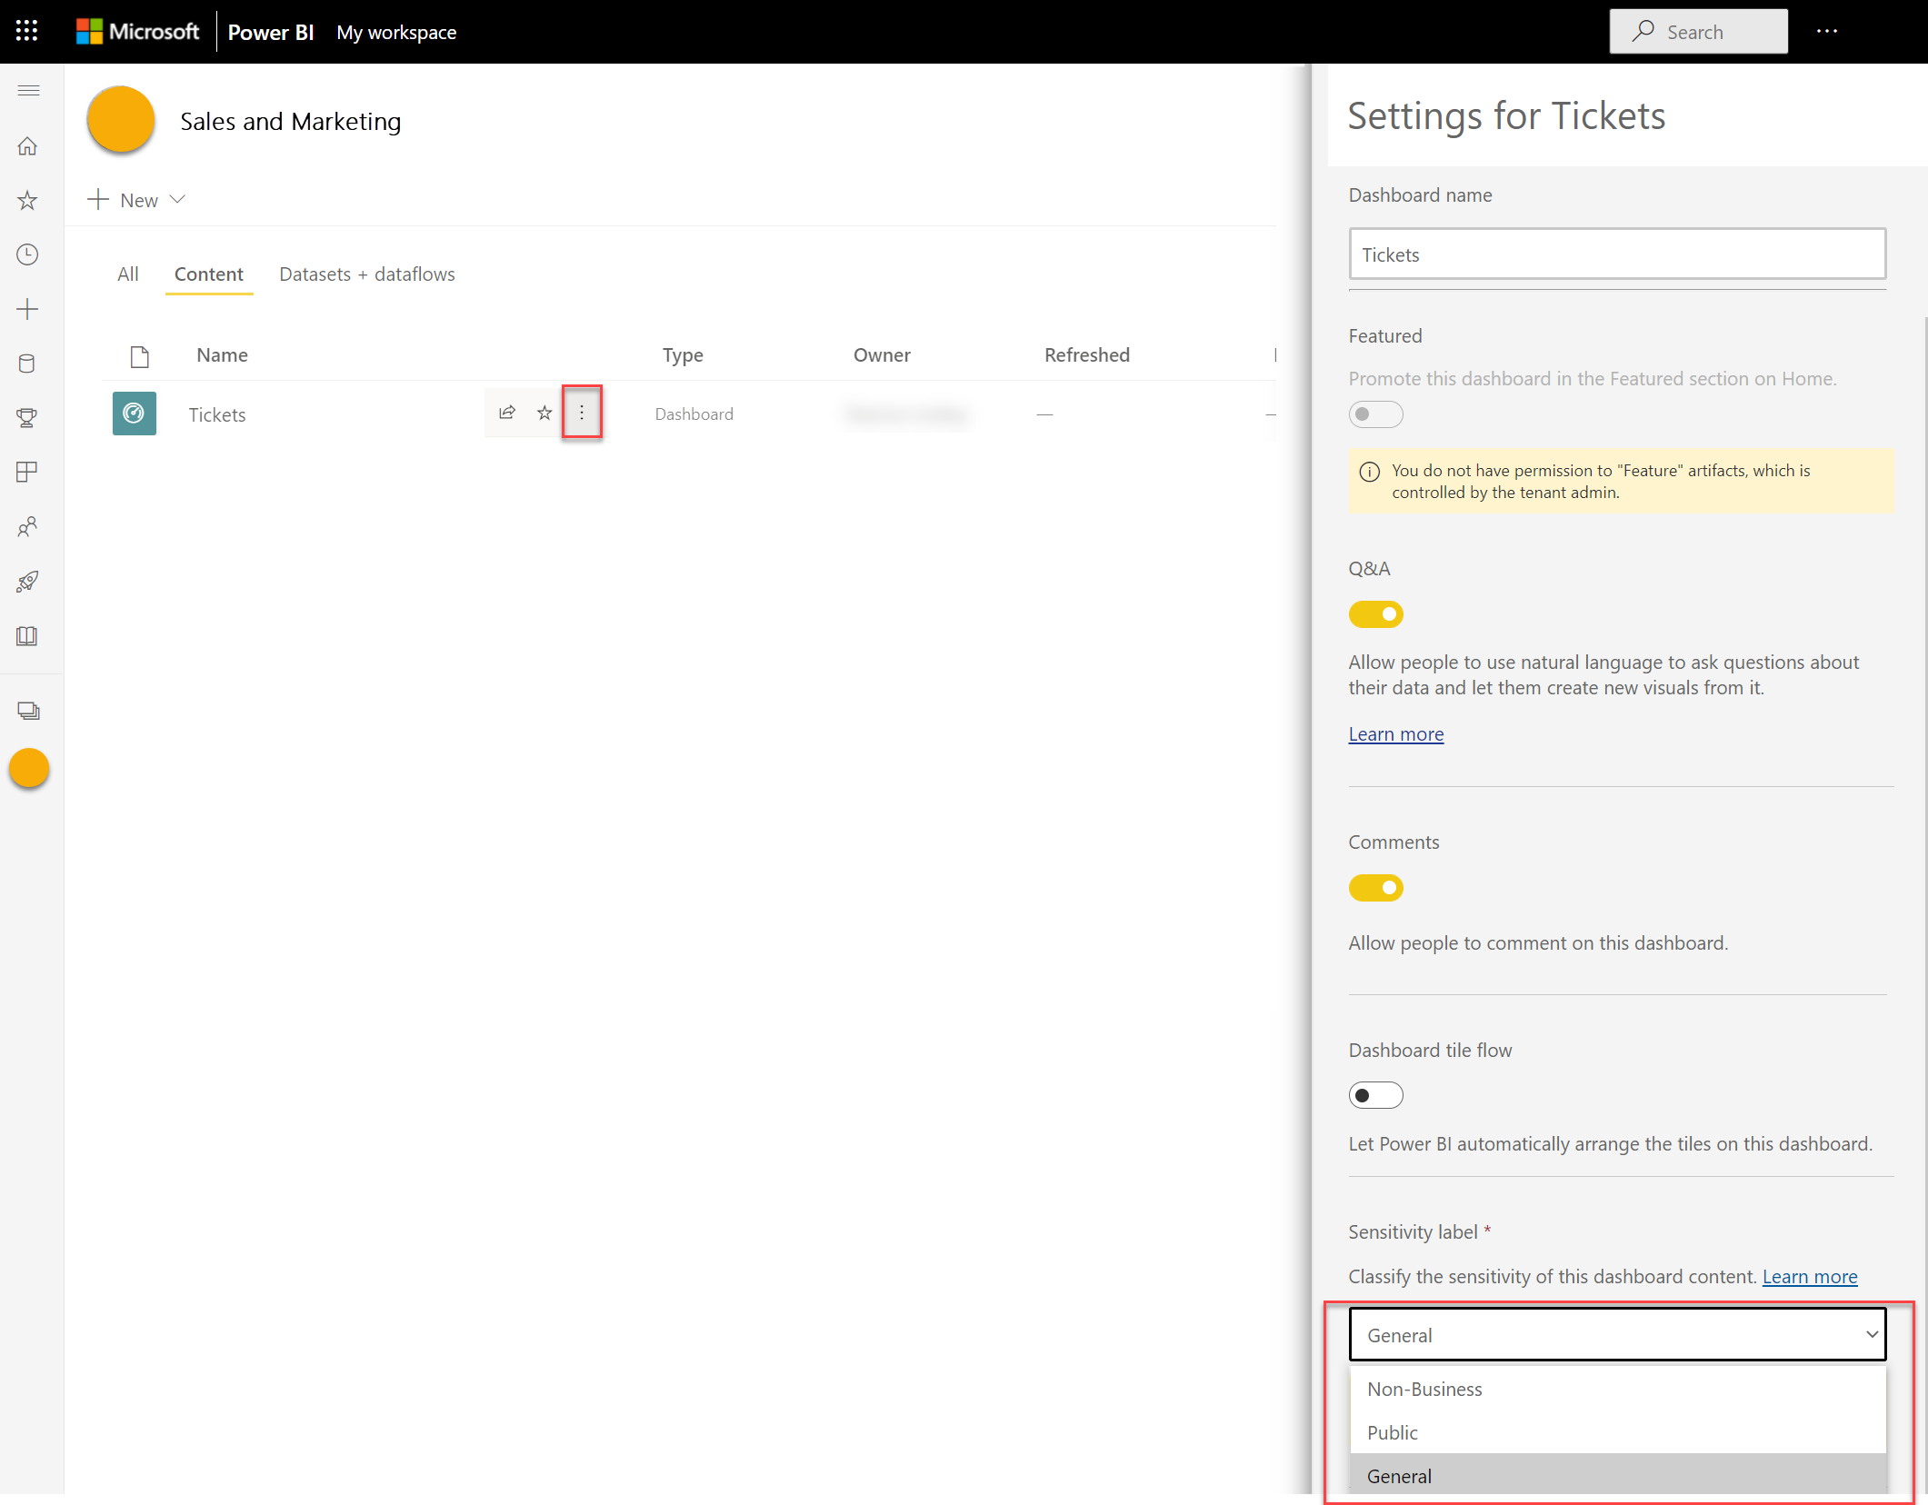
Configure Sensitivity Labels
Notes:
Every dashboard is different. Some dashboards should never be shared with those outside your company or printed out, while others can be shared freely. By using sensitivity labels on dashboards, you will be able to raise awareness with those viewing your dashboards about the appropriate level of security. You can tag your dashboards with labels defined by your company’s IT department, so everyone viewing the content will have the same level of understanding around the sensitivity of the data.
Microsoft Information Protection sensitivity labels on your reports, dashboards, datasets, dataflows, and .pbix files can guard your sensitive content against unauthorized data access and leakage.
Microsoft Information Protection sensitivity labels must be enabled by an admin on the tenant. When data protection is enabled, sensitivity labels appear in the sensitivity column in the list view of dashboards, reports, datasets, and dataflows.

Slide 18
Review Questions (2)
Q01 – What feature allows you to ask a natural-language query about the data?
A01 – The Q&A feature.
Q02 – What feature in dashboards, reports, and datasets is used to alert consumers to the sensitivity of the data?
A02 – Microsoft Information Protection sensitivity labels.

Slide 19
Lab: Create a Power BI Dashboard
Lab: Create a Power BI Dashboard

Slide 20
Module Overview
We covered the following concepts:
Dashboards
Real-time Dashboards
Enhancing Dashboards
Notes:
In this module we discussed:
How to create and use Dashboards
How to create Real-time dashboards
How to enhance existing dashboards

Slide 21

References
PL-300 Create dashboards in Power BI
https://docs.microsoft.com/en-us/learn/modules/create-dashboards-power-bi/

